Slide 1


Noida Institute of Engineering and Technology, Greater Noida
Informed Search Algorithms
Unit: 02
Introduction to Search
B Tech 3rd Sem
Alka Singh
CSE(AIML)

Slide 2
Informed Search Algorithms
So far we have talked about the uninformed search algorithms which looked through search space for all possible solutions of the problem without having any additional knowledge about search space.
But informed search algorithm contains an array of knowledge such as how far we are from the goal, path cost, how to reach to goal node, etc. This knowledge help agents to explore less to the search space and find more efficiently the goal node.

Slide 3
Continue…
The informed search algorithm is more useful for large search space. Informed search algorithm uses the idea of heuristic, so it is also called Heuristic search.
Heuristics function: Heuristic is a function which is used in Informed Search, and it finds the most promising path. It takes the current state of the agent as its input and produces the estimation of how close agent is from the goal. The heuristic method, however, might not always give the best solution, but it guaranteed to find a good solution in reasonable time. Heuristic function estimates how close a state is to the goal.

Slide 4
Continue…
It is represented by h(n), and it calculates the cost of an optimal path between the pair of states. The value of the heuristic function is always positive.
Admissibility of the heuristic function is given as:
h(n) <= h*(n)
Here h(n) is heuristic cost, and h*(n) is the estimated cost. Hence heuristic cost should be less than or equal to the estimated cost.
In the informed search we will discuss two main algorithms which are given below:
Best First Search Algorithm(Greedy search)
A* Search Algorithm

Slide 5
Best-first Search Algorithm (Greedy Search)
Greedy best-first search algorithm always selects the path which appears best at that moment. It is the combination of depth-first search and breadth-first search algorithms. It uses the heuristic function and search. Best-first search allows us to take the advantages of both algorithms. With the help of best-first search, at each step, we can choose the most promising node. In the best first search algorithm, we expand the node which is closest to the goal node and the closest cost is estimated by heuristic function, i.e.
f(n)= h(n). Where, h(n)= estimated cost from node n to the goal.

Slide 6
Continue…
The greedy best first algorithm is implemented by the priority queue.
Best first search algorithm:
Step 1: Place the starting node into the OPEN list.
Step 2: If the OPEN list is empty, Stop and return failure.
Step 3: Remove the node n, from the OPEN list which has the lowest value of h(n), and places it in the CLOSED list.
Step 4: Expand the node n, and generate the successors of node n

Slide 7
Continue…
Step 5: Check each successor of node n, and find whether any node is a goal node or not. If any successor node is goal node, then return success and terminate the search, else proceed to Step 6.
Step 6: For each successor node, algorithm checks for evaluation function f(n), and then check if the node has been in either OPEN or CLOSED list. If the node has not been in both list, then add it to the OPEN list.
Step 7: Return to Step 2.

Slide 8
Continue…
Advantages:
Best first search can switch between BFS and DFS by gaining the advantages of both the algorithms.
This algorithm is more efficient than BFS and DFS algorithms.
Disadvantages:
It can behave as an unguided depth-first search in the worst case scenario.
It can get stuck in a loop as DFS.
This algorithm is not optimal.

Slide 9
Continue…
Example:
Consider the below search problem, and we will traverse it using greedy best-first search. At each iteration, each node is expanded using evaluation function f(n)=h(n) , which is given in the below table.

Slide 10
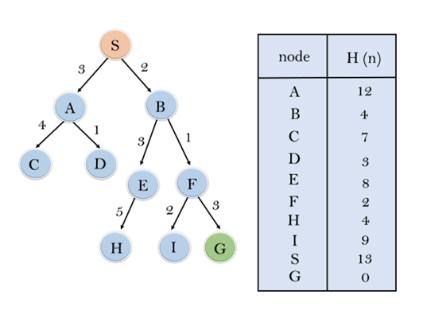
Continue…

Slide 11
Continue…
In this search example, we are using two lists which are OPEN and CLOSED Lists. Following are the iteration for traversing the above example.

Slide 12
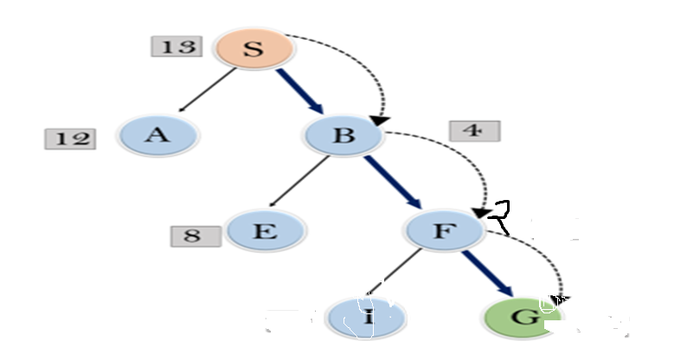
Continue…

Slide 13
Continue…
Expand the nodes of S and put in the CLOSED list
Initialization: Open [A, B], Closed [S]
Iteration 1: Open [A], Closed [S, B]
Iteration 2: Open [E, F, A], Closed [S, B]
: Open [E, A], Closed [S, B, F]
Iteration 3: Open [I, G, E, A], Closed [S, B, F]
: Open [I, E, A], Closed [S, B, F, G]
Hence the final solution path will be: S----> B----->F----> G

Slide 14
Continue…
Time Complexity: The worst case time complexity of Greedy best first search is O(b^{m}).
Space Complexity: The worst case space complexity of Greedy best first search is O(b^{m}). Where, m is the maximum depth of the search space.
Complete: Greedy best-first search is also incomplete, even if the given state space is finite.
Optimal: Greedy best first search algorithm is not optimal.

Slide 15
A* Search Algorithm
A* search is the most commonly known form of best-first search.
It uses heuristic function h(n), and cost to reach the node n from the start state g(n).
It has combined features of UCS and greedy best-first search, by which it solve the problem efficiently.
A* search algorithm finds the shortest path through the search space using the heuristic function.

Slide 16
A* Search Algorithm
A* algorithm is similar to UCS except that it uses g(n)+h(n) instead of g(n).
A* search algorithm use search heuristic as well as the cost to reach the node. Hence we can combine both costs and this sum is called as a fitness number.

Slide 17
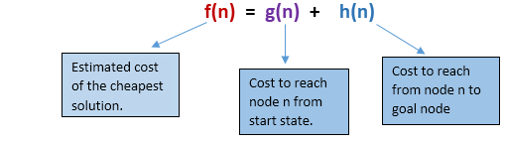
Continue…
At each point in the search space, only those node is expanded which have the lowest value of f(n), and the algorithm terminates when the goal node is found.

Slide 18
Continue…
Algorithm of A* search:
Step1: Place the starting node in the OPEN list.
Step 2: Check if the OPEN list is empty or not, if the list is empty then return failure and stops.
Step 3: Select the node from the OPEN list which has the smallest value of evaluation function (g+h), if node n is goal node then return success and stop, otherwise

Slide 19
Continue…
Step 4: Expand node n and generate all of its successors, and put n into the closed list. For each successor n', check whether n' is already in the OPEN or CLOSED list, if not then compute evaluation function for n' and place into Open list.
Step 5: Else if node n' is already in OPEN and CLOSED, then it should be attached to the back pointer which reflects the lowest g(n') value.
Step 6: Return to Step 2.

Slide 20
Continue…
Advantages:
A* search algorithm is the best algorithm than other search algorithms.
A* search algorithm is optimal and complete.
This algorithm can solve very complex problems

Slide 21
Continue…
Disadvantages:
It does not always produce the shortest path as it mostly based on heuristics and approximation.
A* search algorithm has some complexity issues.
The main drawback of A* is memory requirement as it keeps all generated nodes in the memory, so it is not practical for various large-scale problems.

Slide 22
Continue…
Example:
In this example, we will traverse the given graph using the A* algorithm. The heuristic value of all states is given in the below table so we will calculate the f(n) of each state using the formula f(n)= g(n) + h(n), where g(n) is the cost to reach any node from start state.
Here we will use OPEN and CLOSED list.

Slide 23
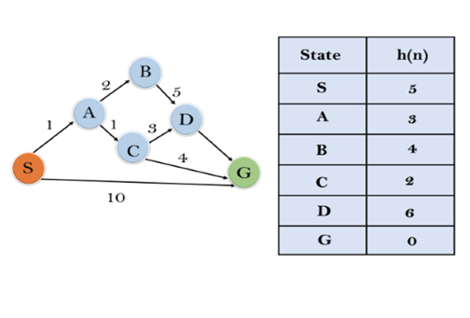
Continue…
Problem:

Slide 24
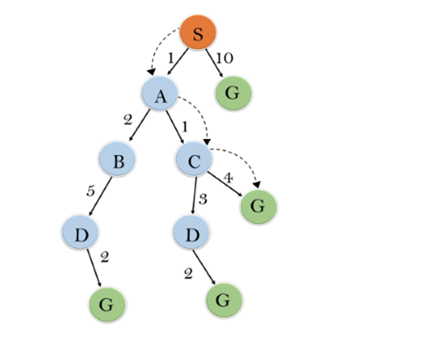
Continue…
Solution:

Slide 25
Continue…
Initialization: {(S, 5)}
Iteration1: {(S--> A, 4), (S-->G, 10)}
Iteration2: {(S--> A-->C, 4), (S--> A-->B, 7), (S-->G, 10)}
Iteration3: {(S--> A-->C--->G, 6), (S--> A-->C--->D, 11), (S--> A-->B, 7), (S-->G, 10)}
Iteration 4 will give the final result, as S--->A--->C--->G it provides the optimal path with cost 6.

Slide 26
Continue…
Points to remember:
A* algorithm returns the path which occurred first, and it does not search for all remaining paths.
The efficiency of A* algorithm depends on the quality of heuristic.
A* algorithm expands all nodes which satisfy the condition f(n).

Slide 27
Continue…
Complete: A* algorithm is complete as long as:
Branching factor is finite.
Cost at every action is fixed.
Time Complexity: The time complexity of A* search algorithm depends on heuristic function, and the number of nodes expanded is exponential to the depth of solution d. So the time complexity is O(b^d), where b is the branching factor.
Space Complexity: The space complexity of A* search algorithm is O(b^d)

Slide 28
Generate and Test algorithm
The generate and test algorithm is as follows :
1.Generate a possible solutions.
2. Test to see if this is the actual solution.
3. If the solution has been found, quit else go to step 1.

Slide 29
MCQ
Q1. What is the other name of informed search strategy?
a) Simple search
b) Heuristic search
c) Online search
d) None of the mentioned

Slide 30
MCQ
Q2. Which search uses the problem specific knowledge beyond the definition of the problem?
a) Informed search
b) Depth-first search
c) Breadth-first search
d) Uninformed search
Answer: a
Informed search can solve the problem beyond the function definition, So does it can find the solution more efficiently.

Slide 31
MCQ
Q3. What is the heuristic function of greedy best-first search?
a) f(n) != h(n)
b) f(n) < h(n)
c) f(n) = h(n)
d) f(n) > h(n)
Answer: c

Slide 32
MCQ
Q4. Which search is complete and optimal when h(n) is consistent?
a) Best-first search
b) Depth-first search
c) Both Best-first & Depth-first search
d) A* search
Answer: d

Slide 33
MCQ
Q5. Which is used to improve the performance of heuristic search?
a) Quality of nodes
b) Quality of heuristic function
c) Simple form of nodes
d) None of the mentioned
Answer: b

Slide 34
MCQ
Q6. Which search method will expand the node that is closest to the goal?
a) Best-first search
b) Greedy best-first search
c) A* search
d) None of the mentioned
Answer: b

Slide 35
MCQ
Q7. A heuristic is a way of trying ___________
a) To discover something or an idea embedded in a program
b) To search and measure how far a node in a search tree seems to be from a goal
c) To compare two nodes in a search tree to see if one is better than another
d) All of the mentioned
Answer: d

Slide 36
MCQ
Q8. A* algorithm is based on ___________
a) Breadth-First-Search
b) Depth-First –Search
c) Best-First-Search
d) Hill climbing
Answer: c

Slide 37
MCQ
Q9. The search strategy the uses a problem specific knowledge is known as ___________
a) Informed Search
b) Best First Search
c) Heuristic Search
d) All of the mentioned
Answer: d

Slide 38
MCQ
Q10. Uninformed search strategies are better than informed search strategies.
a) True
b) False
Answer: b

Slide 39
MCQ
Q11. Best-First search is a type of informed search, which uses _____ to choose the best next node for expansion.
a) Evaluation function returning lowest evaluation
b) Evaluation function returning highest evaluation
c) Evaluation function returning lowest & highest evaluation
d) None of them is applicable
Answer: a

Slide 40
MCQ
Q12. Best-First search can be implemented using the following data structure.
a) Queue
b) Stack
c) Priority Queue
d) Circular Queue
Answer: c

Slide 41
MCQ
Q13. Heuristic function h(n) is ________
a) Lowest path cost
b) Cheapest path from root to goal node
c) Estimated cost of cheapest path from root to goal node
d) Average path cost
Answer: c

Slide 42
MCQ
Q14 . Greedy search strategy chooses the node for expansion in ___________
a) Shallowest
b) Deepest
c) The one closest to the goal node
d) Minimum heuristic cost
Answer: c

Slide 43
MCQ
Q15. What is the space complexity of Greedy search?
a) O(b)
b) O(bl)
c) O(m)
d) O(bm)
Answer: d

Slide 44
MCQ
Q16. What is the evaluation function in greedy approach?
a) Heuristic function
b) Path cost from start node to current node
c) Path cost from start node to current node + Heuristic cost
d) Average of Path cost from start node to current node and Heuristic cost
Answer: a

Slide 45
MCQ
Q 17. What is the evaluation function in A* approach.
a) Heuristic function
b) Path cost from start node to current node
c) Path cost from start node to current node + Heuristic cost
d) Average of Path cost from start node to current node and Heuristic cost
Answer: c

Slide 46
References
American Association for Artificial Intelligence (AAAI), Welcome to AI Topics, 2003, http://www.aaai.org/AITopics/ -- a Web-based library.
George Luger, Artificial Intelligence: Structures and Strategies for Complex Problem Solving, Fourth Edition Addison-Wesley, 2002 -- a well-respected introduction to artificial intelligence, as witnessed by its being in its fourth edition.
Peter Norvig, AI on the Web, http://aima.cs.berkeley.edu/ai.html -- a list of over 800 links on various aspects of artificial intelligence.

Slide 47


